Slide 1

ADVANCED SYSTEMS ANALYSIS AND DESIGN
CIS 301
TOPIC 2
ITERATIVE-INCREMENTAL PROCESS MODE

Slide 2
Software Development Models?

Slide 3
The development models are the various processes or methodologies that are being selected for the development of the project depending on the project’s aims and goals.
There are many development life cycle models that have been developed in order to achieve different required objectives.
The models specify the various stages of the process and the order in which they are carried out.

Slide 4

The selection of model has very high impact on the testing that is carried out.
It will define the what, where and when of our planned testing, influence regression testing and largely determines which test techniques to use.

Slide 5
There are various Software development models or methodologies. They are as follows:
Waterfall model
V model
Incremental model
RAD model
Agile model
Iterative model
Spiral model

Slide 6

Waterfall model

Slide 7

The Waterfall Model was first Process Model to be introduced.
It is also referred to as a linear-sequential life cycle model.
It is very simple to understand and use.

Slide 8
Waterfall Model
Requirements
Design
Code & Unit Test
Test & Integration
Operations & Maintenance

Slide 9
V-model

Slide 10
V- model means Verification and Validation model.
Just like the waterfall model, the V-Shaped life cycle is a sequential path of execution of processes.
Each phase must be completed before the next phase begins.
Testing of the product is planned in parallel with a corresponding phase of development.

Slide 11
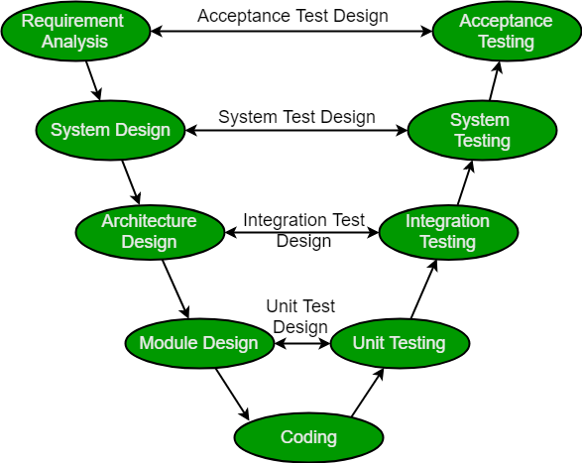

Slide 12
Incremental model

Slide 13
In incremental model the whole requirement is divided into various builds.
Multiple development cycles take place here, making the life cycle a “multi-waterfall” cycle.
Cycles are divided up into smaller, more easily managed modules.
Each module passes through the requirements, design, implementation and testing phases.

Slide 14
A working version of software is produced during the first module, so you have working software early on during the software life cycle.
Each subsequent release of the module adds function to the previous release.
The process continues till the complete system is achieved.

Slide 15

In the diagram above when we work incrementally, we are adding piece by piece but expect that each piece is fully finished. Thus keep on adding the pieces until it’s complete.

Slide 16
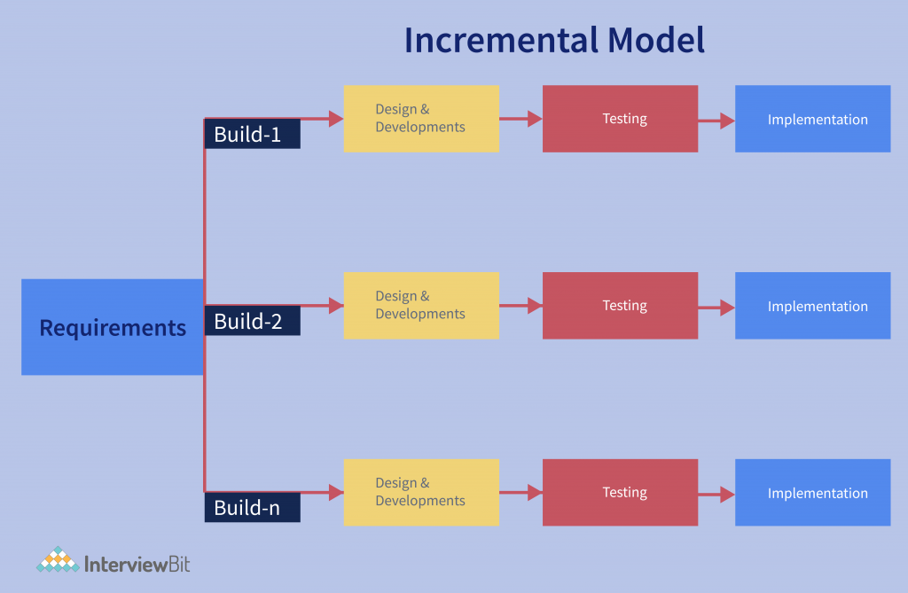

Slide 17
Advantages of Incremental model:
Generates working software quickly and early during the software life cycle.
More flexible – less costly to change scope and requirements.
Easier to test and debug during a smaller iteration.
Customer can respond to each built.
Lowers initial delivery cost.
Easier to manage risk because risky pieces are identified and handled during it’d iteration.

Slide 18
Disadvantages of Incremental model:
Needs good planning and design.
Needs a clear and complete definition of the whole system before it can be broken down and built incrementally.
Total cost is higher than waterfall.

Slide 19
When to use the Incremental model:
Requirements of the complete system are clearly defined and understood.
Major requirements must be defined; however, some details can evolve with time.
There is a need to get a product to the market early.
A new technology is being used
Resources with needed skill set are not available
There are some high risk features and goals.

Slide 20
RAD model

Slide 21
RAD model is Rapid Application Development model.
It is a type of incremental model.
In RAD model the components or functions are developed in parallel as if they were mini projects.
The developments are time boxed, delivered and then assembled into a working prototype.
This can quickly give the customer something to see and use and to provide feedback regarding the delivery and their requirements.

Slide 22
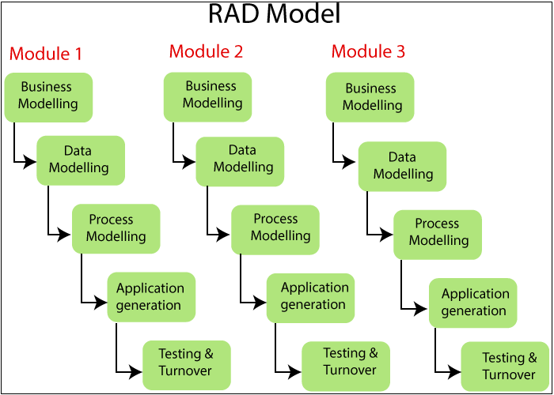

Slide 23
Agile model

Slide 24
Agile development model is also a type of Incremental model.
Software is developed in incremental, rapid cycles.
This results in small incremental releases with each release building on previous functionality.
Each release is thoroughly tested to ensure software quality is maintained.
It is used for time critical applications. Extreme Programming (XP) is currently one of the most well known agile development life cycle model.

Slide 25
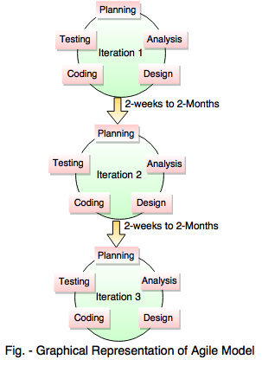

Slide 26
Iterative model

Slide 27
An iterative life cycle model does not attempt to start with a full specification of requirements.
Instead, development begins by specifying and implementing just part of the software, which can then be reviewed in order to identify further requirements.
This process is then repeated, producing a new version of the software for each cycle of the model.

Slide 28

In the diagram above when we work iteratively we create rough product or product piece in one iteration, then review it and improve it in next iteration and so on until it’s finished.

Slide 29
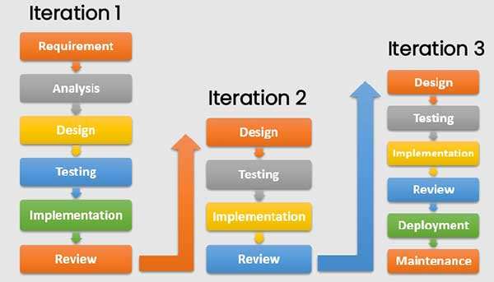

Slide 30
Advantages of Iterative model:
In iterative model we can only create a high-level design of the application before we actually begin to build the product and define the design solution for the entire product.
Later on we can design and built a skeleton version of that, and then evolved the design based on what had been built.
In iterative model we are building and improving the product step by step.
Hence we can track the defects at early stages. This avoids the downward flow of the defects.

Slide 31
Disadvantages of Iterative model:
Each phase of an iteration is rigid with no overlaps
Costly system architecture or design issues may arise because not all requirements are gathered up front for the entire lifecycle

Slide 32
When to use iterative model:
Requirements of the complete system are clearly defined and understood.
When the project is big.
Major requirements must be defined; however, some details can evolve with time.

Slide 33
Spiral model

Slide 34
The spiral model is similar to the incremental model, with more emphasis placed on risk analysis.
The spiral model has four phases: Planning, Risk Analysis, Engineering and Evaluation.
A software project repeatedly passes through these phases in iterations (called Spirals in this model).
The baseline spiral, starting in the planning phase, requirements are gathered and risk is assessed.

Slide 35
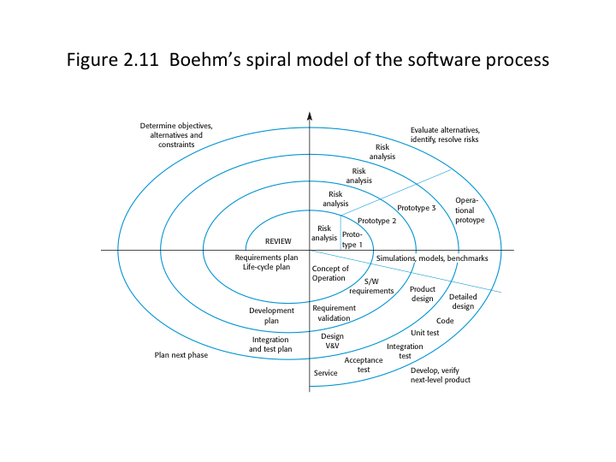

Slide 36
Prototype model

Slide 37
The basic idea here is that instead of freezing the requirements before a design or coding can proceed, a throwaway prototype is built to understand the requirements.
This prototype is developed based on the currently known requirements.
By using this prototype, the client can get an “actual feel” of the system, since the interactions with prototype can enable the client to better understand the requirements of the desired system.

Slide 38
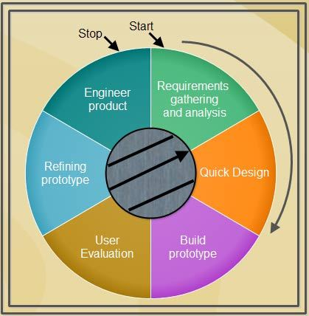

Slide 39

End of TOPIC 2

